Slide 1
Director Memorandum 2026-72
Discussion Regarding Fire Station Roof Replacement
August 20, 2026

Slide 2
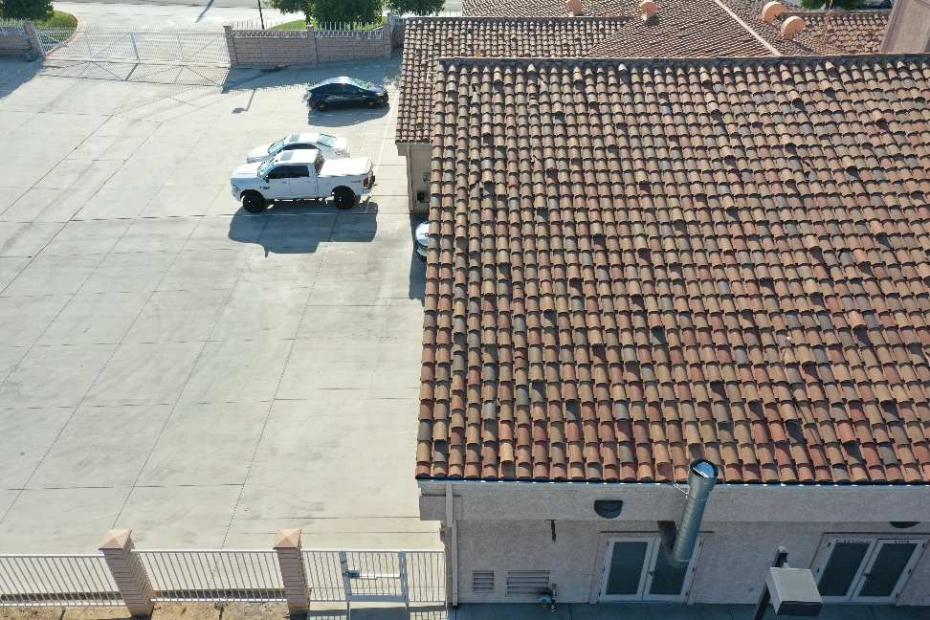
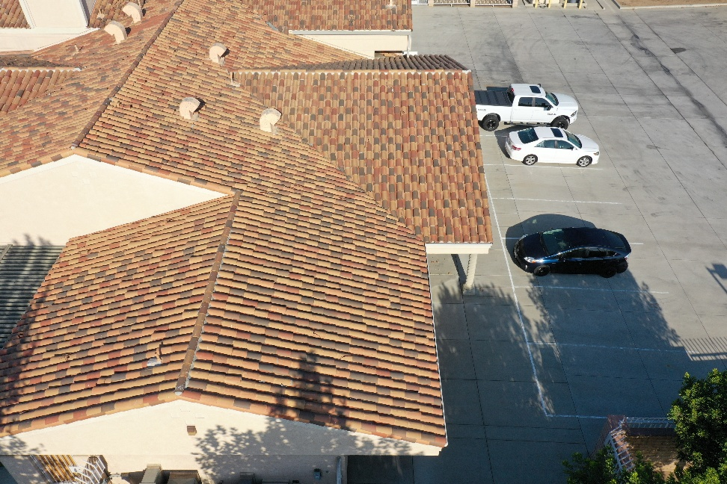
Current Roof Condition

Slide 3
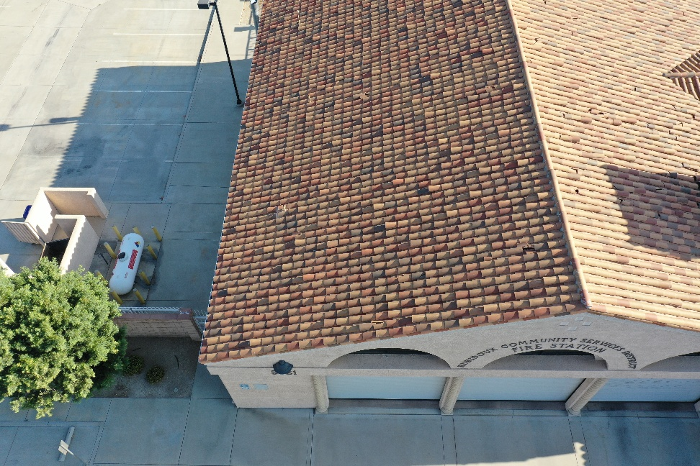
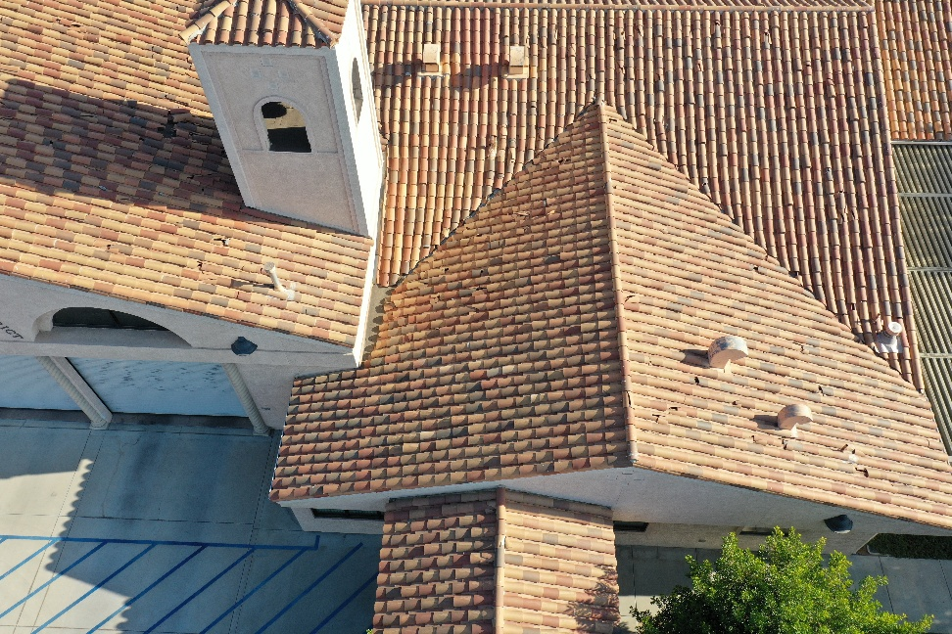

Slide 4
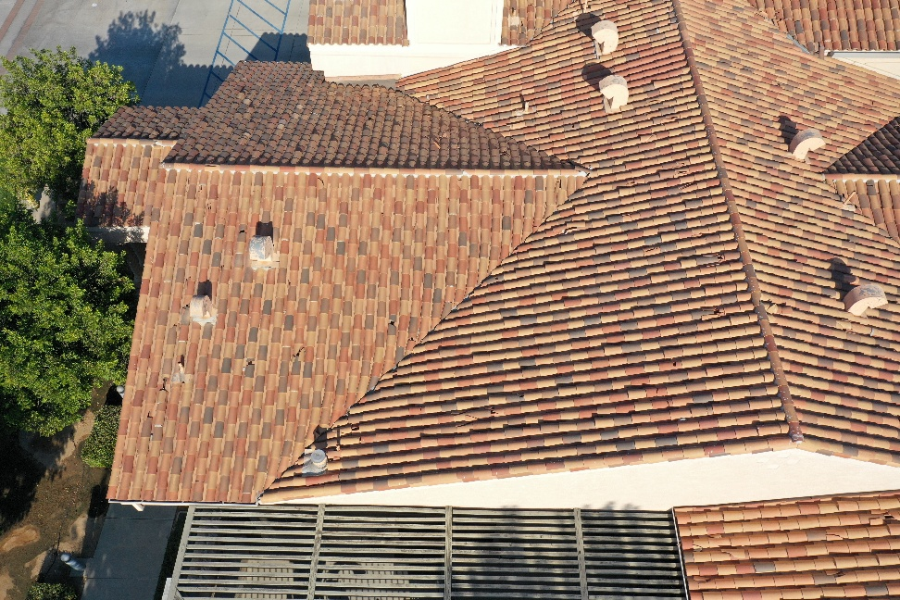
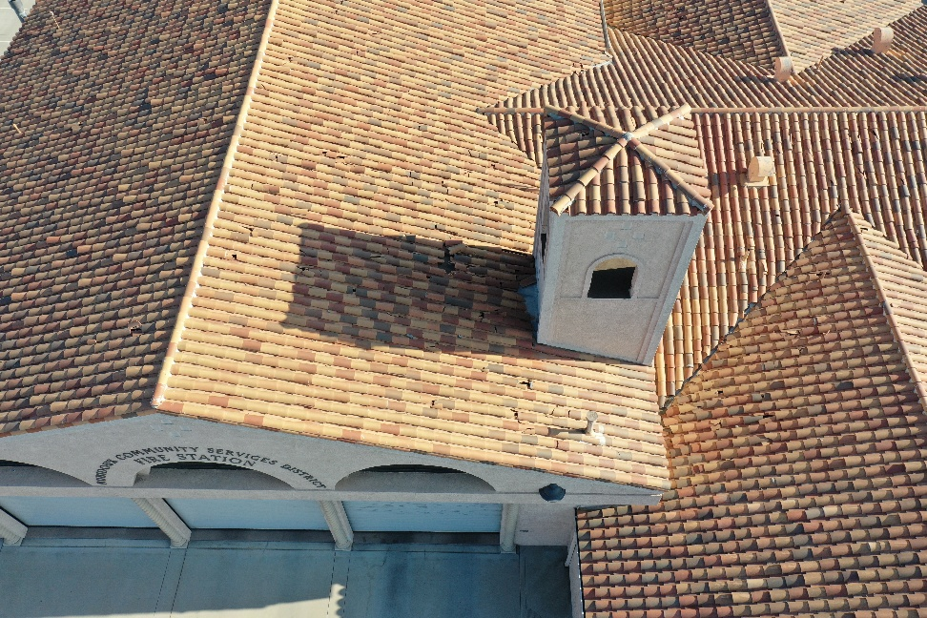

Slide 5


Slide 6
Option 1: Concrete or Clay Tile Roofing
Description
This option replaces the existing roof with a new tile roofing system that maintains similar appearance of the facility. Tile style would be evaluated for potential foot traffic to avoid risk of damage.
Benefits
• Long service life, often exceeding 50 years when properly maintained. [roofobservations.com]
• Excellent resistance to fire, an important characteristic for emergency service facilities.
• Attractive appearance is consistent with Southern California architecture.
• Durable against ultraviolet (UV) exposure and extreme heat.
• Individual tiles can be replaced if damaged.
Drawbacks
• Highest structural weight of the options reviewed.
• More expensive installation costs.
• Individual tiles can crack from foot traffic or falling debris.
• Periodic maintenance is required to replace broken tiles and maintain the underlayment.
Suitable For
• Facilities where architectural appearance is a high priority and long-term aesthetics are important.

Slide 7
Option 2: Standing Seam Metal Roofing
Description
Standing seam metal roofing consists of continuous metal panels with raised seams that interlock together to provide weather protection.
Benefits
• Service life typically ranges from 40 to 70 years.
• Excellent fire resistance.
• Extremely durable in high heat and severe weather conditions.
• Lightweight compared to tile roofs.
• Minimal maintenance requirements.
• Reflective coatings can significantly reduce summer cooling costs.
• Compatible with future solar panel installations.
Drawbacks
• Higher initial cost than some membrane roofing systems.
• May require specialized contractors for installation.
• Can experience cosmetic denting from severe impacts.
Suitable For
• Public safety facilities seeking a long-lasting, resilient roofing system with low maintenance costs.

Slide 8
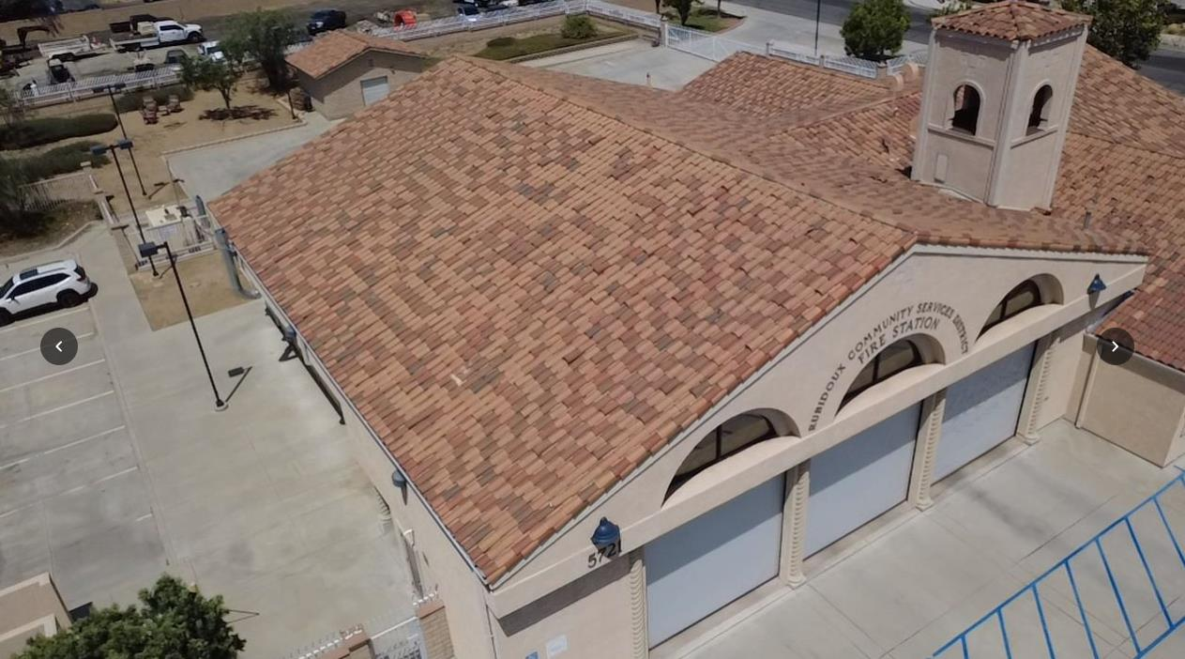

Slide 9
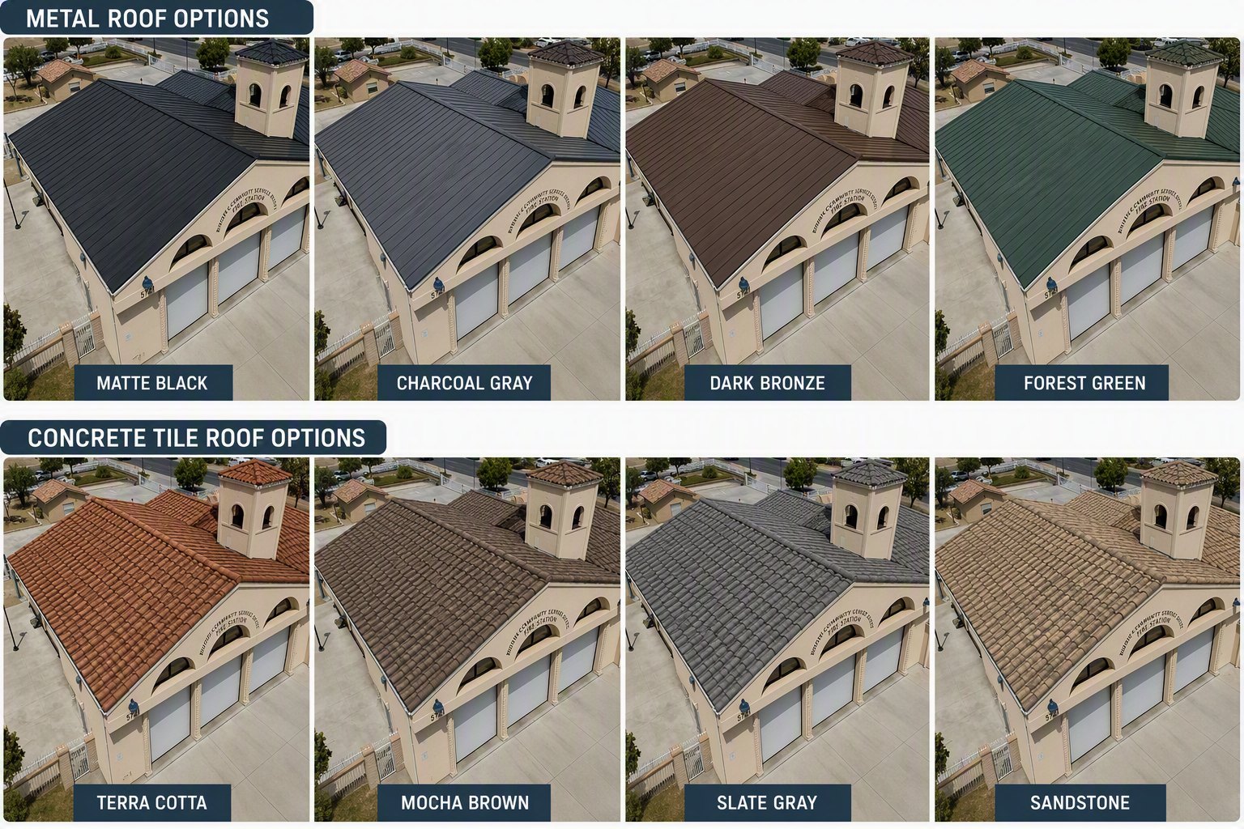

Slide 10
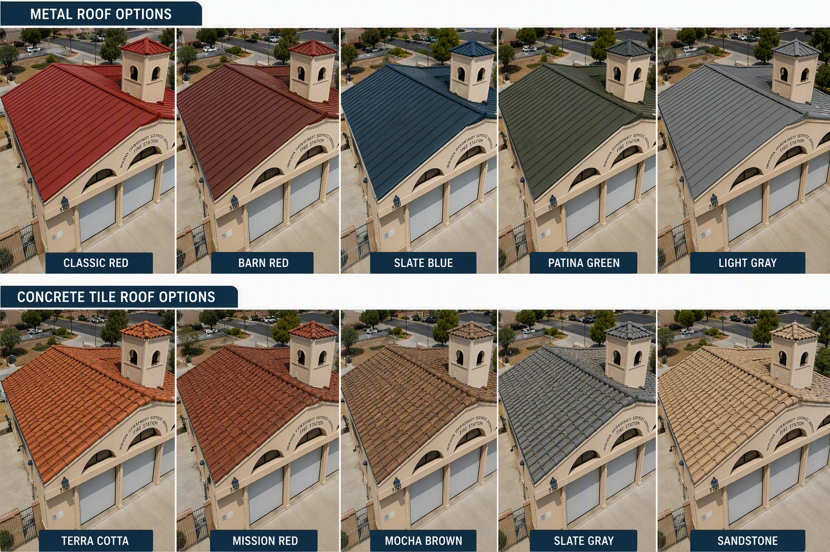

Slide 11
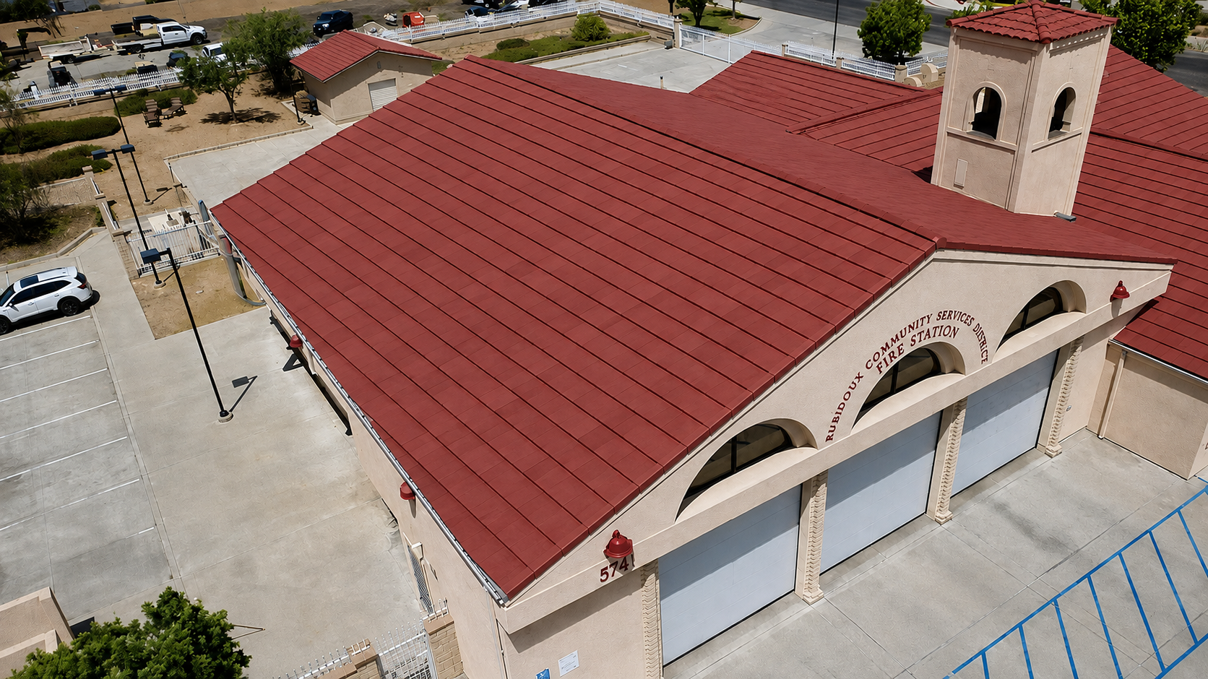

Slide 12
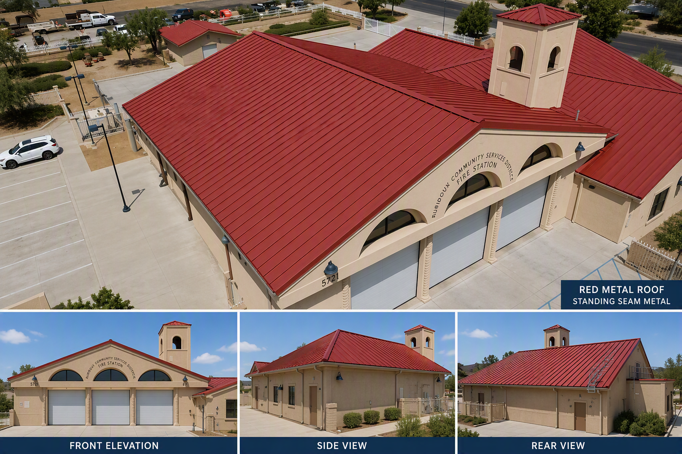

Slide 13
Summary
1. Standing Seam Metal Roofing
Provides the best balance of durability, low maintenance, fire resistance, and long-term value.
2. New Concrete or Clay Tile Roof
Maintains the existing appearance of the station and provides excellent longevity, though at a higher maintenance burden.
Currently the Fire Station has approximately $4.1 million in fire mitigation funds available. These are funds restricted for capital fire station related activity. Also, in the FY 2026|2027 Fire / Weed Abatement Fund Budget is $250,000 (Line 20) which is allocated for asset acquisitions and replacements (Attachment 1).

Slide 14
Questions
Rubidoux Community Services District
Office: 951.684.7580
www.rcsd.org
14

