Slide 1
DM 2026-59 Consideration to Award Advanced Metering Infrastructure (AMI) Implementation Project (Rebid)
Staff Report
July 2, 2026
1

Slide 2
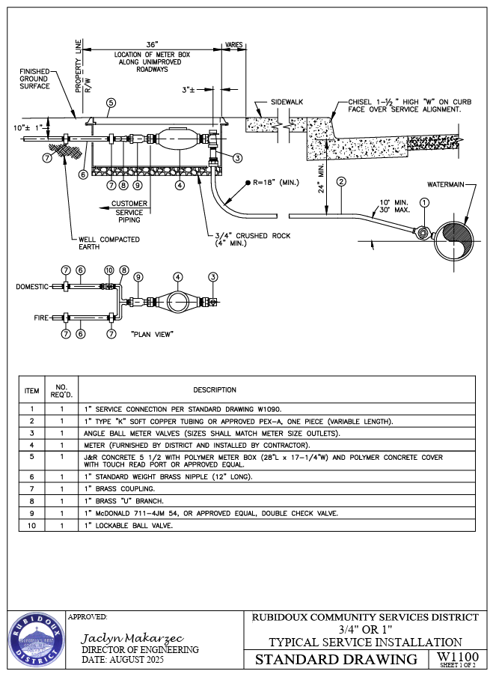
Introduction
RCSD serves approximately 39,000 customers potable drinking water by water service connections. Each customer service line is connected to our system with valves, piping, and a meter tracking how much water each customer uses.
2

Slide 3
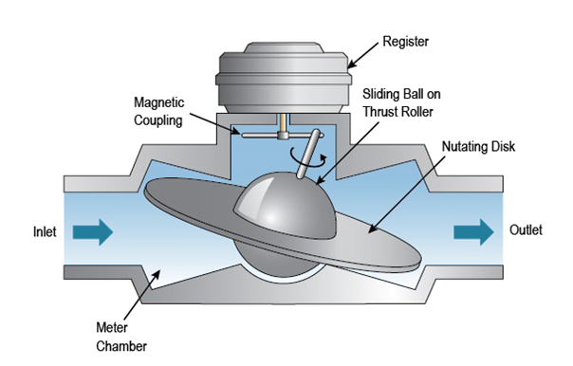
Background
Total Number of Water Meters is approximately 6,900
Average life expectancy for residential meters (dependent on type) = 15 to 20 years
Approximately 50% of Districts meters are older than 15 years
Grant obtained is a matching grant with a maximum of $1,500,000
Image: https://www.pnnl.gov/projects/femp-metering-best-practices/water-metering
3

Slide 4
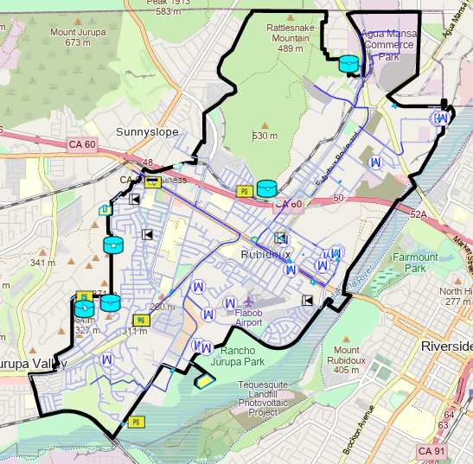

Current Practice
Collect meter reads by roue (which are assigned at the time of construction when meter is installed).
Each customer’s billing start and end periods vary from each other (most of the time neighborhoods will be grouped together)
Each cycle is between 30 to 35 days
Each day the Meter Reader collects approximately 400 meter reads
4

Slide 5
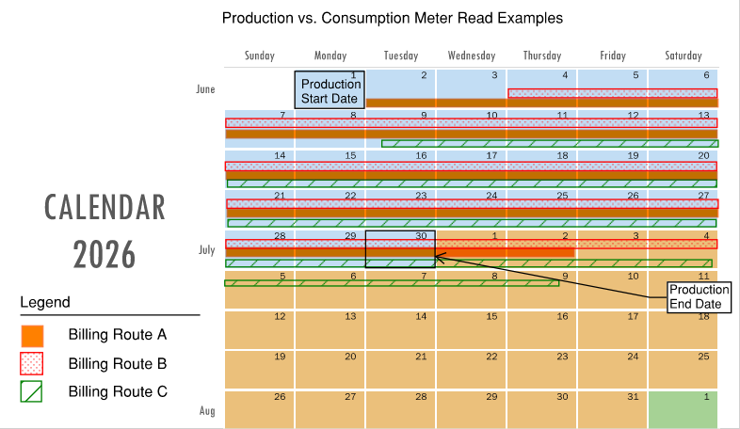
Impacts Production vs Consumption
5
Notes:
Each month our team compares water produced (from meters at Wells) to water consumed (from customer meters) to determine water lost.
The challenge in this is that the data does not algin since each route has a specific time frame and the meter reads are a different time frame

Slide 6
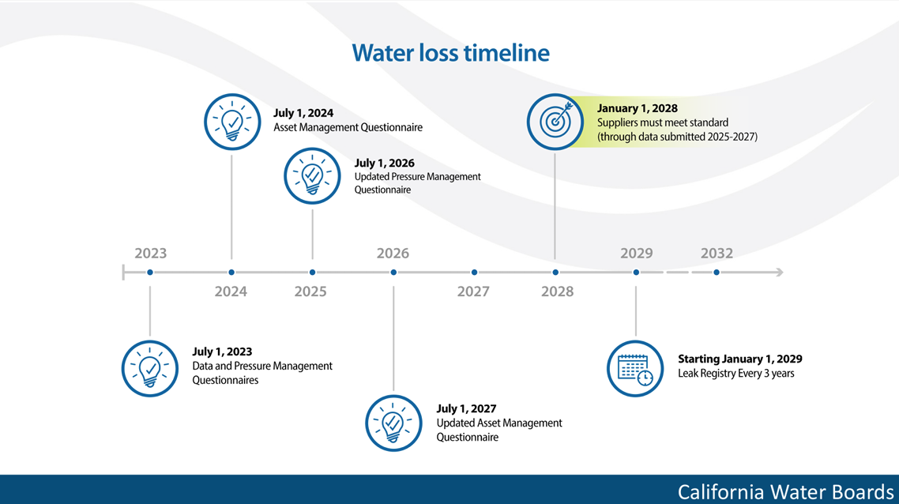
Making Conservation a California Way of Life
6

Slide 7
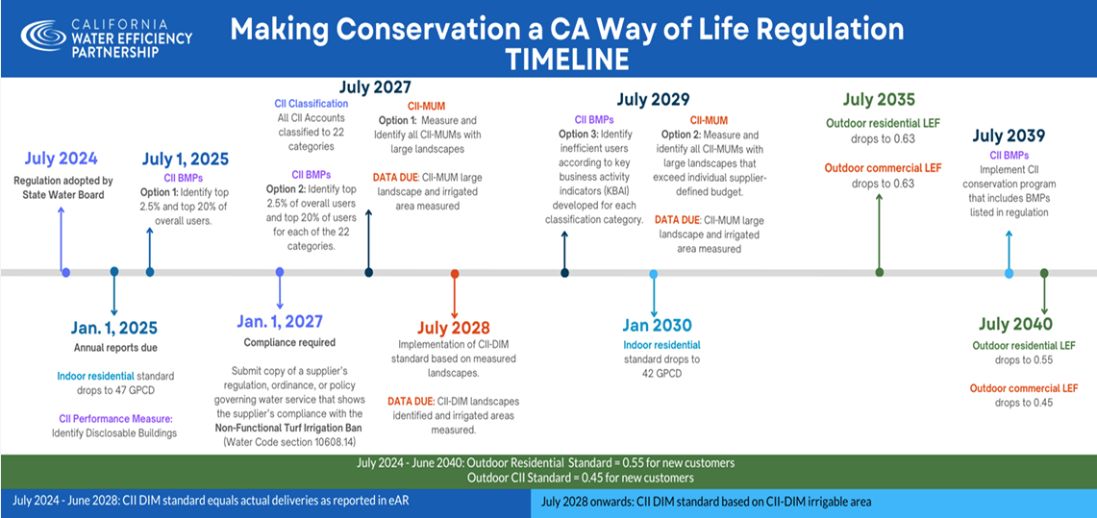
7

Slide 8
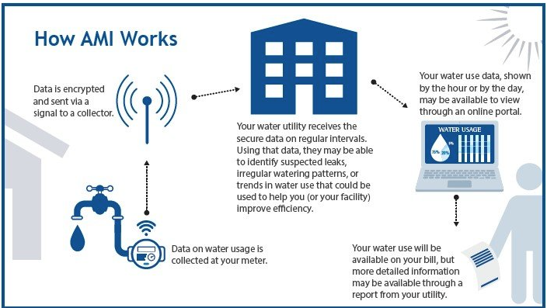
AMI Overview
https://www.epa.gov/watersense/advanced-metering-infrastructure
8

Slide 9
Project History
2021 – Application for USBR WaterSmart Grant to replace meters with AMI meters (Not Awarded)
2022 – Application for USBR WEEG Program to replace meters with AMI meters
2023 – Notice of Award
2024 – AMI Technical Specifications (single manufacturer) added to RCSD Standards
2025 – Bidding of AMI Project (Not Awarded)
2025 – AMI Technical Specifications Revised
2026 – Rejection of Bids and Rebid Using Revised AMI Technical Specifications – with Leak Detection and Increased Warranty
2026 – Consideration to Award AMI Project
2027 – Estimated Project Completion April 2027
9

Slide 10
Bids Results Comparison
Meter Size | Quantity | Ferguson Unit Cost (Bronze) | Core & Main Unit Cost (Stainless Steel Unless Noted Otherwise)
3/4" | 4,725 | $477.41 | $383.62 (Composite – 3,725) $395.84 (Stainless Steel – 1,000)
1" | 106 | $519.82 | $464.80
1-1/2" | 58 | $1,265.72 | $1,284.77
2" | 83 | $1,470.59 | $1,621.72
3" | 2 | $3,722.25 | $2,480.96
4" | 5 | $4,595.50 | $3,035.63
6" | 3 | $6,893.69 | $5,685.72
Project Total | 4,982 | $3,217,511.59 | $2,616,125.23
10

Slide 11
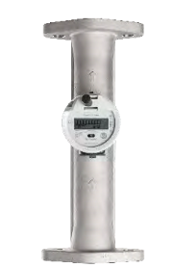
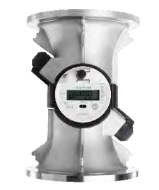
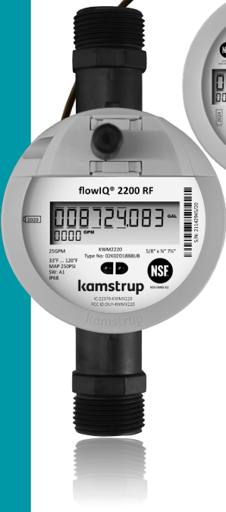
Core & Main
Proposed Meter: Kamstrup FlowIQ
Multiple intelligent alarms and info codes let you quickly detect irregularities such as leaks and bursts or other events like tampering attempts, reverse flow, and support the following info codes and alarms:
Dry
Reverse
Leak
Burst*
Tamper
Low battery
Low temperature
High temperature
Max flow exceeded*
No consumption
Overflow**
*Not Available on flowIQ 4200 Large Meters 6”-12”
**Not Available on flowIQ 2200 1” and smaller
11

Slide 12
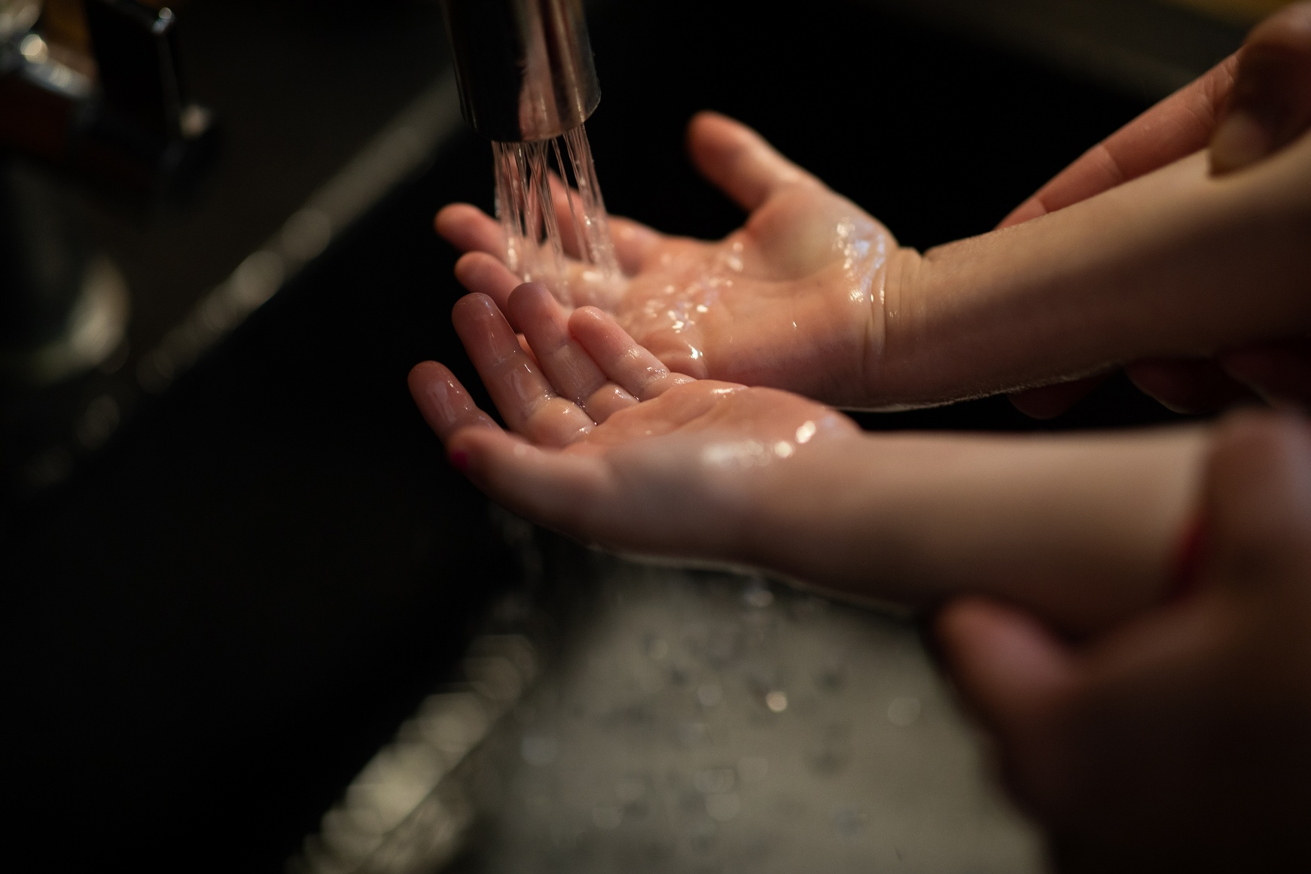
Customer Education and Empowerment
12

Slide 13
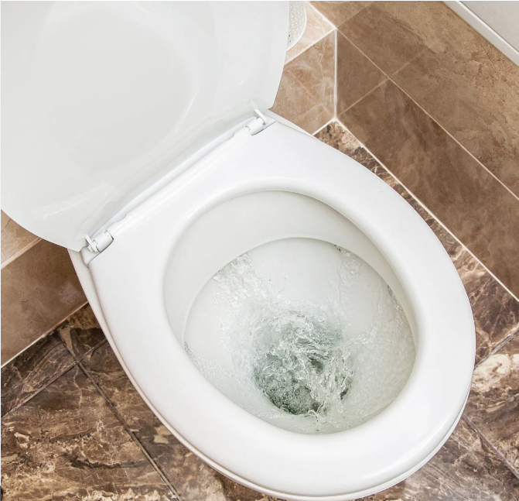
Example of a Leak
Leaking Toilet for One Year
Average Person Uses 83 gallons per day
= 2.3 years worth of water for a single person
Wastes Approximately 70,000 gallons of Water (per EPA)
13

Slide 14
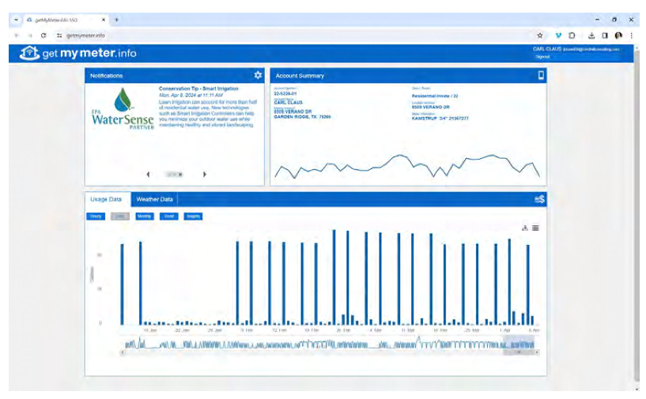
Customer Portal
14

Slide 15
Recommendation
Accept the Core & Main Bid of $2,616,125.23 received for the Rebid AMI project and issue Notice to Proceed to Core & Main.
Authorize the District Staff to initiate and execute change orders for the project as needed to increase the quantity of meters and ancillary items supplied by $383,874.77 (resulting in a total project cost of $3,000,000).
This is estimated to be about 900 more meters bringing the total number of meters replaced to approximately 5,900
Authorize District Staff to utilize $200,000 as a contingency for the Project.
15

Slide 16
Questions
Rubidoux Community Services District
Office: 951.684.7580
www.rcsd.org
16
16

