Slide 1
DM 2025-75:
Consideration to Modify Assistant Engineer Position: 1) Fiscal Year 2025|2026 Salary Schedule Adjustment; 2) Job Descriptions; and 3) Organizational Chart
Staff Presentation
August 7, 2025
1

Slide 2
Introduction
RCSD has a minimal Engineering Staff of three (including Director of Engineering) and is responsible for review and design oversight of all water and sewer infrastructure (Developer and Capital Improvement Projects (CIP)), Planning, Funding, Regulatory Reporting, and a variety of other highly technical work.
2

Slide 3
Background
A crucial role in the Engineering Staff is the Assistant Engineer - they work to support the Director of Engineering and ensure regulatory compliance.
The Assistant Engineer position has been vacant since June 2, 2025.
3

Slide 4
Purpose
Modify the Assistant Engineer position to provide growth and development opportunities for Engineering Staff
Implement Industry Standard qualifications for Position
Revise the Salary Schedule to be consistent with Industry and other Water Districts
Modify the job description to be consistent with duties
4

Slide 5
Proposed Revisions
Modify the Assistant Engineer position to provide growth and development opportunities for Engineering Staff:
  Reduce Position Responsibilities for the Assistant Engineer to align with an entry-level position. Oversight and close supervision to develop engineering judgement and independent work
  Create Associate Engineer Position for mid-level Professional Engineer capable of working independently and utilizing engineering judgement
5

Slide 6
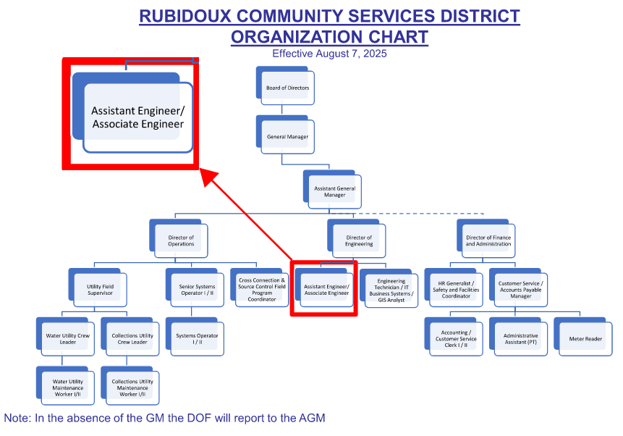
Proposed Revisions
6

Slide 7
Proposed Revisions
2. Implement Industry Standard qualifications for Position:
  Assistant Engineer – Bachelor's Degree in Civil Engineering (or equivalent) with one (1) year or more of engineering experience capable of obtaining an Engineer In Training (EIT) license within one (1) year of employment
  Associate Engineer – Bachelor's Degree in Civil Engineering (or equivalent) with five (5) years of progressively responsible engineering experience with an active license as a Professional Civil Engineer in CA.
7

Slide 8
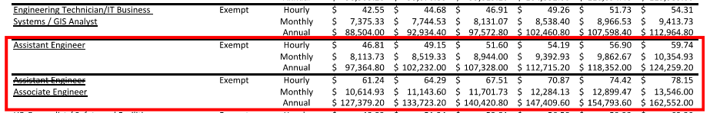
Proposed Revisions
3. Revise the Salary Schedule to be consistent with Industry and other Water Districts:
  Assistant Engineer – Reduce current Assistant Engineer's Salary to be 10% higher than Engineering Technician/IT Business Systems/GIS Analyst
  Associate Engineer – Use current Assistant Engineer's Salary Schedule and rename as Associate Engineer
8

Slide 9
Proposed Revisions
4. Modify the job description to be consistent with duties:
Primary changes add the technical responsibilities associated with a support engineering position.
Allow the Support Engineer to exercise and demonstrate engineering understanding and judgement.
9

Slide 10
Questions
Rubidoux Community Services District
Office: 951.684.7580
www.rcsd.org
10
10

