Slide 1
Director Memorandum 2026-60
Consideration to Establish a Street Sweeping Signage and Installation Budget and Authorize Implementation of Street Sweeping Route Signage
July 2, 2026

Slide 2
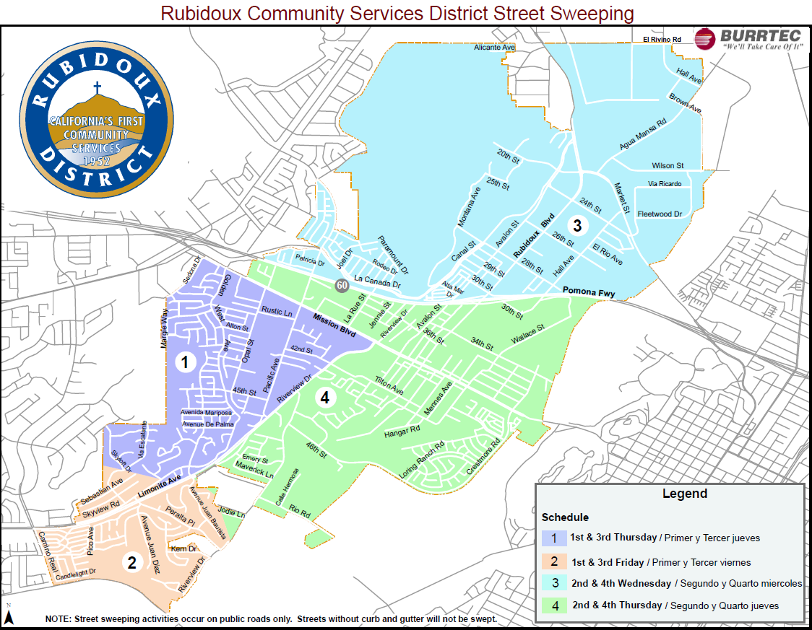
Background
July 1, 2025 – Amendment #3 (Burrtec) – 4 routes, 2x per month

Slide 3
Sign Inventory and Route Evaluation
Existing signage is obsolete and faded.
Installation:
  Community entrances off major streets (Limonite, Mission, Rubidoux) or from outside District service boundaries.
  Streets with curb and gutters.
  Edison poles (concrete) and City-owned standalone poles.
  Installed using District forces while cataloging locations.
  Period: Q1 – FY 26|27

Slide 4
Route Stability Considerations
Current routes established July 1, 2025.
Burrtec expects routes to remain unchanged for the foreseeable future.

Slide 5
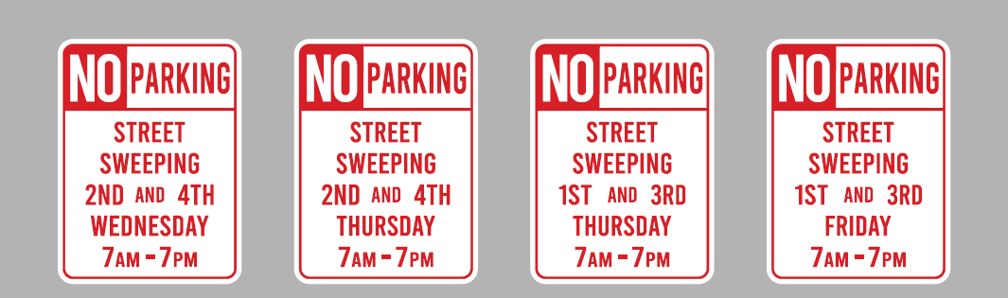
Signage
18” x 24” High Intensity Reflective Laminate – Useful life ~ 10 years

Slide 6
Cost and Installation

Slide 7
Budget Considerations
Staff is requesting $15,000 to complete this project.
Amount will cover sign procurement and other unforeseen costs.
Amount not considered in the FY 2026|2027 Trash Fund Budget a requires a budget amendment.
Proposed funding from General Fund Unrestricted Property Tax Reserve.

Slide 8
Recommendation
Amend the FY 2026|2027 Trash Fund Budget to establish a new operating expenditure line item titled “Street Sweeping Signage and Installation” in the amount of $15,000.
Appropriate funding for the budget amendment from the District’s Unrestricted Property Tax Reserve.
Authorize staff to proceed with implementation of the street sweeping signage program.

Slide 9
Questions
Rubidoux Community Services District
Office: 951.684.7580
www.rcsd.org
9

