Slide 1
DM 2026- 54 Consider Approval of
“Water for Tomorrow”
School Art Contest Program
June 18, 2026
1

Slide 2
Background
At the direction of the Board of Directors, staff developed the “Water for Tomorrow” Art Contest to enhance community engagement and strengthen youth outreach efforts throughout the District’s service area.
The Art Contest creates partnerships between the District and local schools within the service area.
The program aligns with similar initiatives implemented by agencies such as the Metropolitan Water District of Southern California and other regional water agencies.
This program provides a structured platform for students to express their understanding of water-related issues through visual art while supporting educators with ready-to-use thematic content.
2

Slide 3
Program Overview
The art contest will be open to schools within the District’s service area, including but not limited to:
  Ina Arbuckle Elementary School
  Peralta Elementary School
  West Riverside Elementary School
  Pacific Avenue Academy of Music
  Rustic Lane Elementary School
  Mission Middle School
  Rubidoux High School
3

Slide 4
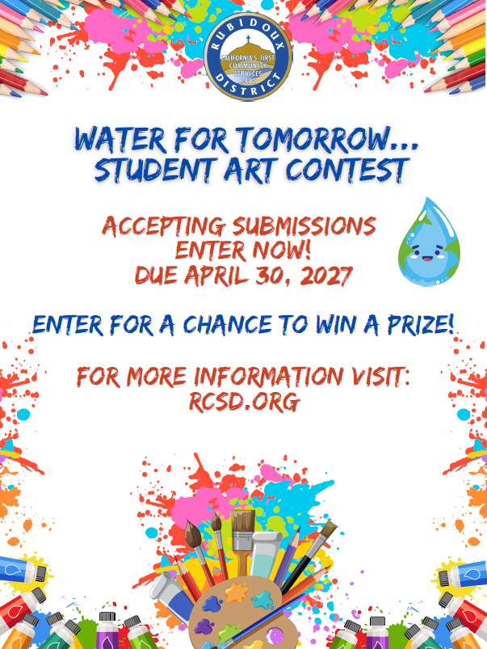
Program Timeline
Program Timeline
  January – April: Student submission period (during school year)
  May: Review and voting/judging period
  June: Announcement of winners and recognition
4

Slide 5
Guidelines Summary
Eligibility and Participation
  Open only to students within designated District-area schools
  Entries must be original work created solely by the student
  Submissions must be appropriate to the student’s age, grade, and skill level
Artwork Requirements
  Size: 12” x 18” standard format
  Orientation: Landscape (horizontal only)
  Medium: White poster board or plain white drawing paper only
  Border: 1-inch clean white border required on all sides
5

Slide 6
Judging and Scoring
Judging Panel
  Water industry professionals
  Educators
  Community representatives
Scoring is based on a 100-point rubric allocated as follows:
  Theme Clarity – 20 points
  Creativity and Originality – 20 points
  Neatness and Overall Quality – 20 points
  Visual Impact – 20 points
  Water Conservation Message – 20 points
6

Slide 7
Awards
Winners will be selected in each of the following grade categories:
  K–5
  6–8
  9–12
Each category will include:
  First Place: $100
  Second Place: $75
  Third Place: $50
7

Slide 8
Budget Considerations
The “Water for Tomorrow” Art Contest is anticipated to have minimal fiscal impact to the District with cost limited to outreach materials such as printed flyers, educational handouts, and paper supplies provided to participating schools upon request.
In addition, the program includes student recognition awards with a total annual prize allocation of $675, distributed across three grade categories (K–5, 6–8, and 9–12), with first, second, and third place awards provided in each category.
Funding for this program will be supported through the District’s General Fund and will be drawn from either discretionary property tax revenues or interest income earned on those funds.
The program is not funded by ratepayer revenues.
Staff time required is anticipated to be absorbed within existing operational workloads and does not require additional staffing.
8

Slide 9
Recommendation
Staff recommends that the Board of Directors approve the establishment and implementation of the “Water for Tomorrow” School Art Contest as presented.
9

Slide 10
Questions
Rubidoux Community Services District
Office: 951.684.7580
www.rcsd.org
10
10

