Slide 1
DM 2025-49
Cross-Connection Control Ordinance 2025-141
Staff Presentation
6-5-2025

Slide 2
What is a Cross-Connection?
A cross-connection is any actual or potential connection between a potable (drinkable) water system and a source of contamination or pollution.
These connections can allow backflow—the reverse flow of water or other substances—into the public water system.
Common examples include hose bibs, irrigation systems, fire sprinkler systems, or boilers connected without proper backflow protection.
Preventing cross-connections is critical to protecting public health and water quality.
2

Slide 3
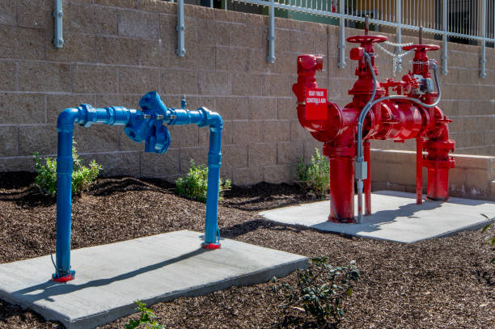
Common Backflow Examples
3

Slide 4
Cross-Connection Control Ordinance 2025-141
Today we are conducting the first reading of Ordinance No. 2025-141, which updates and modernizes the District’s Cross-Connection Control Ordinance in response to new regulatory requirements established by the State Water Resources Control Board’s Cross-Connection Control Policy Handbook (CCCPH). This handbook became effective on July 1, 2024, and replaces the former California Title 17 Regulations.
4

Slide 5
Cross-Connection Control Ordinance 2025-141
As part of our compliance efforts, the District is required to submit a revised Cross-Connection Control Plan to the State Water Board by July 1, 2025. A key component of that plan is an enforceable local ordinance. Ordinance No. 2025-141 meets the new CCCPH requirements and will repeal and replace Ordinance No. 86, which was adopted under the now-repealed Title 17 framework.
5

Slide 6
Key Differences Between Ordinance No. 86 and Ordinance No. 2025-141
Legal Authority: Ordinance 2025-141 includes updated enforcement provisions that align with the CCCPH and California Health & Safety Code, ensuring the District can take corrective action when users fail to comply.
Hazard Assessment: The new ordinance mandates formalized hazard assessments for new and existing service connections, with documentation and timeframes.
Testing Requirements: Establishes detailed requirements for the inspection and field testing of backflow prevention assemblies (BPAs), including minimum frequencies and tester qualifications.
Certified Testers: Ordinance 2025-141 requires all BPA testing to be conducted by certified personnel using calibrated equipment, with results submitted in an approved format.
6

Slide 7
Key Differences Between Ordinance No. 86 and Ordinance No. 2025-141 Continued
Incident Response: Introduces required procedures for responding to and reporting backflow incidents, including customer notifications.
Tracking and Documentation: Requires a centralized tracking system to maintain current records of devices, test results, hazard levels, and corrective actions.
Coordination and Outreach: Emphasizes coordination with local building and health officials and introduces public education requirements to increase awareness of cross-connection hazards.
7

Slide 8
Conclusion
Once adopted, Ordinance 2025-141 will serve as the legal foundation for our Cross-Connection Control Program and be submitted with our final plan to the State.
Staff recommends the Board of Directors consider the following:
Schedule a Public Hearing and Final Reading of Ordinance No. 2025-141 for the June 19, 2025, regular meeting of the Board of Directors of the Rubidoux Community Services District.
8

Slide 9
Questions
Rubidoux Community Services District
Office: 951.684.7580
www.rcsd.org
9

