Slide 1
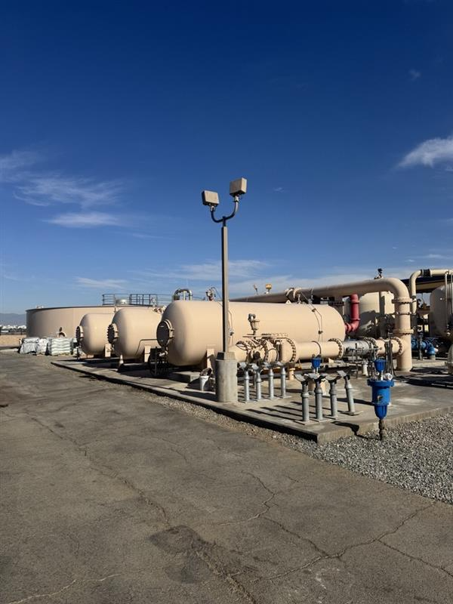

Leland Thompson Plant
Hydraulic Reliability
Improvements
Building on recent water quality progress by reducing water hammer and protecting the Atkinson Zone.
August 20, 2026
Notes:
Talking points:
Open with the big picture: this is not simply a valve replacement. Thompson has become a more complex plant over time, and this project is the next step in protecting both the plant and the Atkinson pressure zone.

Slide 2
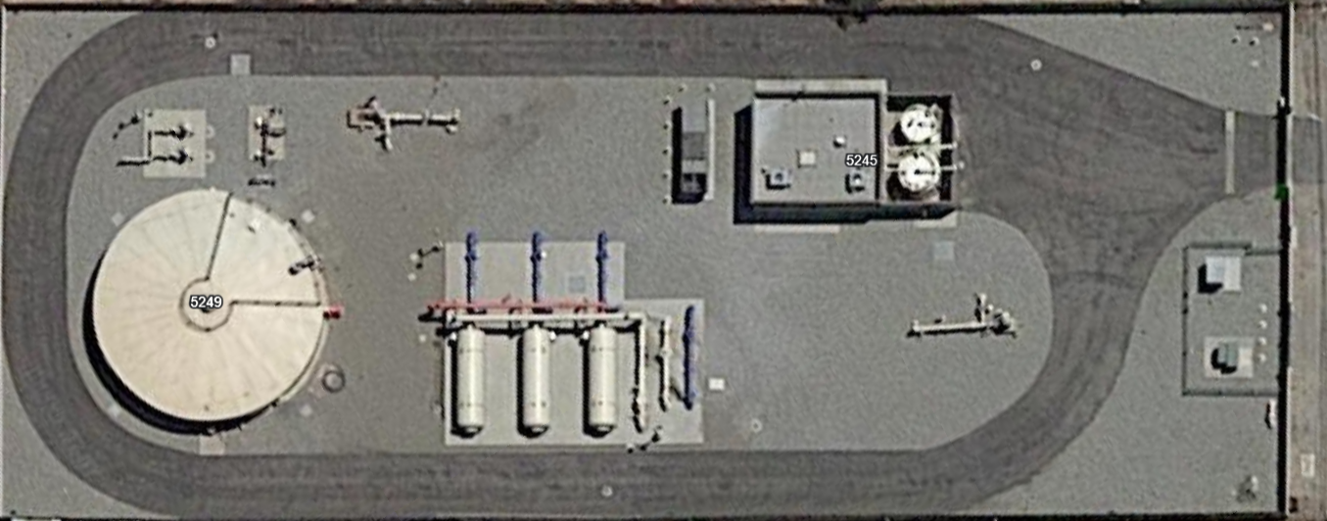
Thompson Plant was built for a simpler job
The original plant was designed around a much simpler hydraulic path: two supply wells, manganese removal, disinfection, and delivery to the system.
2012 Original Configuration
Original equipment was matched to that original plant.
Chlorine
Disinfection
Atkinson Zone
The valves, pneumatic actuators, vessel controls and programing date back to that simpler operating environment.
130 PSI Operating Range
Distribution
Backwash
Tank
Filtronics Vessels
Well 18
Manganese Removal
Well 17
Plant Influent Water
RCSD | Thompson Plant Hydraulic Reliability Improvements
2
Notes:
Talking points:
Keep this nontechnical. Say: Thompson was built to do one primary job—remove manganese from water supplied by two wells. That is the context the original valves and controls were built around.

Slide 3
The Plant has evolved over time to meet emerging water quality Regulations
Every improvement helped water quality - but the plant became hydraulically more restrictive.
2012
2018
2019
2021
Today
Thompson built
Well 2 GAC
Well 8A / 1A
PFAS IX added
More complex plant
Manganese treatment around original supply configuration.
Well 2 treatment and blending adds operational dependence.
Additional source wells become part of the Thompson operating picture.
Ion exchange treatment added for PFAS removal.
More piping, valves, instruments, and headloss.
The treatment process improved. The original valve and plant control architecture did not keep pace.
RCSD | Thompson Plant Hydraulic Reliability Improvements
3
Notes:
Talking points:
Tell the story as modernization, not failure. We have had to add treatment to meet changing water quality requirements. Those additions made the water safer, but also made the plant more complex.

Slide 4
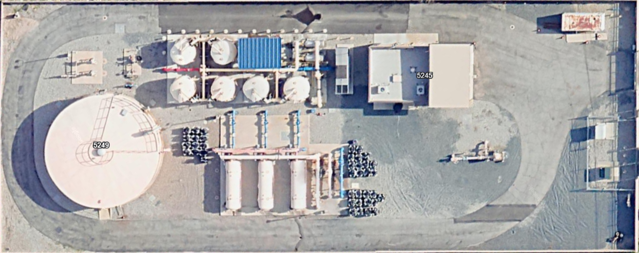
Thompson Plant 2026 Configuration
Three groundwater sources now operate through the Thompson system: Wells 18, 1A, and 8.
PFAS ion-exchange treatment was added in 2021, including sodium bisulfite feed, cartridge prefilters, additional vessels, piping, valves, and instrumentation.
The added treatment processes created additional flow restriction and headloss, reducing available flow and increasing operating pressure within the plant.
Much of the original valve, actuator, and vessel-control equipment remains from the original plant, even though the hydraulic conditions it operates under have changed substantially.
.
PFAS Pre Filters
Sodium
Bisulfite
Original equipment is not compatible with today's configuration
170-190 PSI Operating Range
Chlorine
Disinfection
Atkinson Zone
Distribution
Backwash
Tank
Well 18
Filtronics Vessels
Manganese Removal
Well 1A
Plant Influent Water
Well 8
RCSD | Thompson Plant Hydraulic Reliability Improvements
4
Notes:
Talking points:
Keep this nontechnical. Say: Thompson was built to do one primary job—remove manganese from water supplied by two wells. That is the context the original valves and controls were built around.

Slide 5
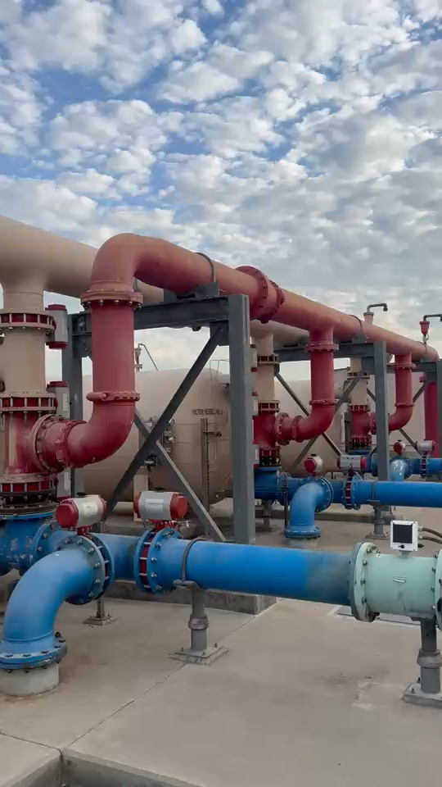

Slide 6
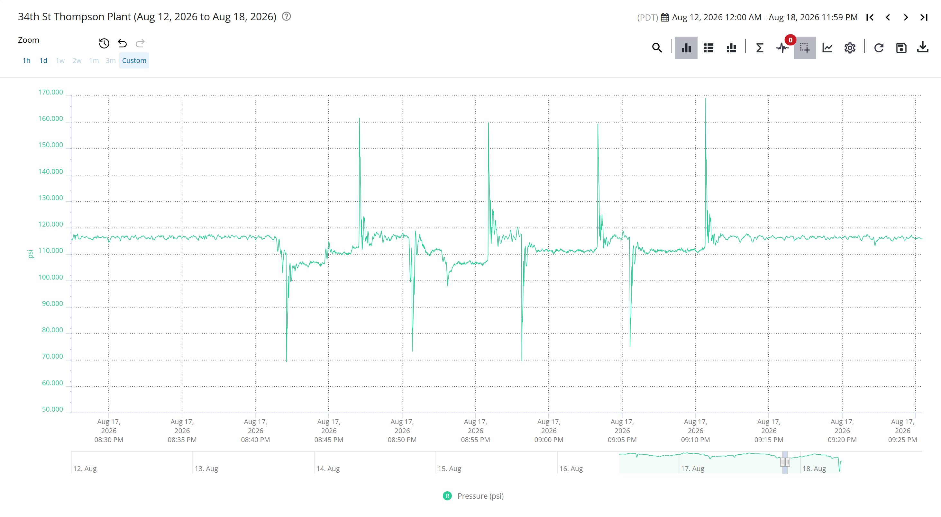
Pressure Swings Suring Backwash Cycle
256/sec
pressure readings captured
Pressure Swing felt in
Atkinson Zone
≈100 psi
≈30 min
RCSD | Thompson Plant Hydraulic Reliability Improvements
6
Notes:
Talking points:
Explain that ordinary SCADA trends can miss very short spikes. These transmitters collect 256 readings per second so we can see the fast pressure events. Emphasize that the swing is felt in the Atkinson pressure zone, not just inside the fence.

Slide 7
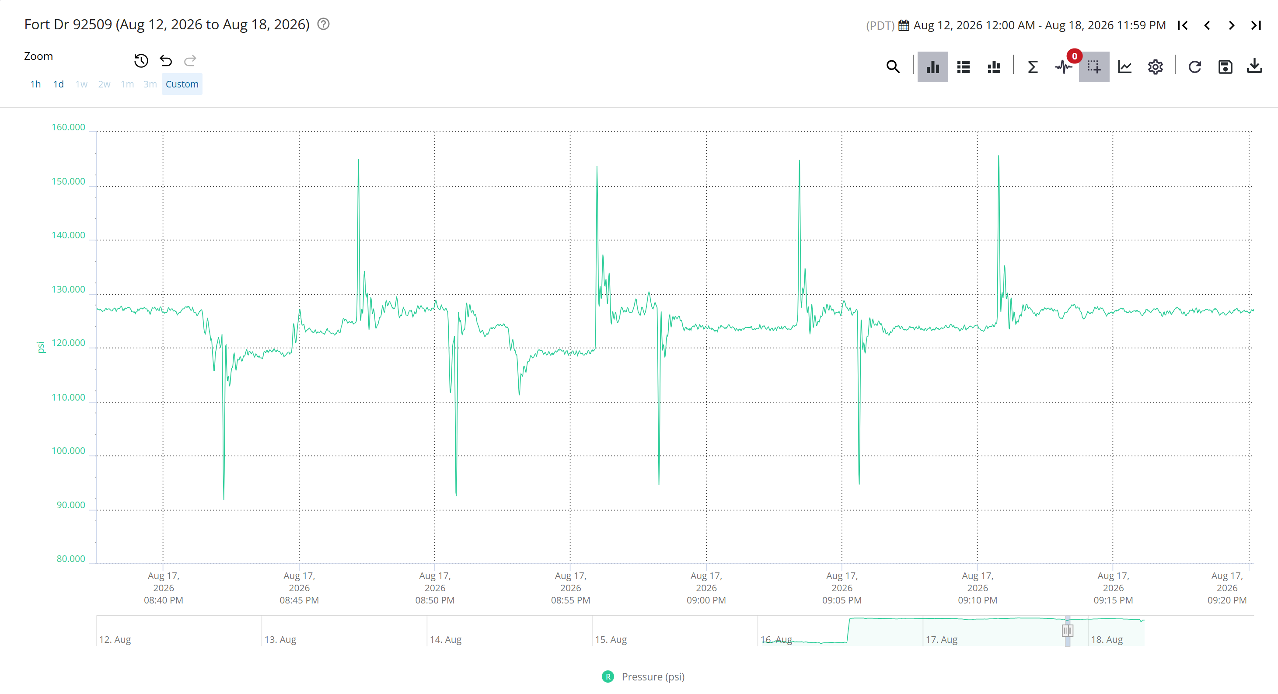
7

Slide 8
WHY THE PRESSURE SWING MATTERS
Water hammer creates a chain reaction
At Thompson, rapid backwash valve transitions can create pressure waves felt through the Atkinson Zone.
~100 PSI
pressure swing
1
Moving water
2
Valves move fast
3
Pressure wave
4
System stress
Water has momentum
Flow changes suddenly
Energy travels through pipe
Pipes and appurtenances absorb it
What absorbs the pressure wave?
5
Mains break
6
Emergency repairs
7
Service interruptions
Mains • services • meters • hydrants • valves • fittings
Project goal: control valve timing at the source so a backwash transition does not become a system-wide stress event.
RCSD | Thompson Plant Hydraulic Reliability Improvements
8

Slide 9
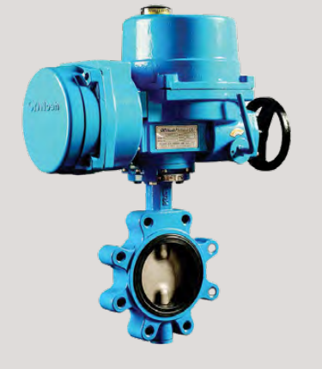
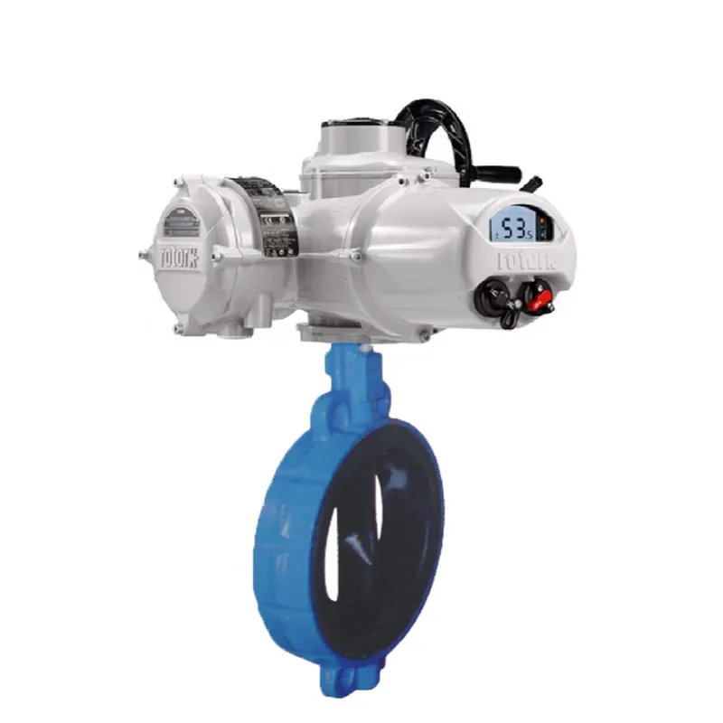
The Solution: Control The Pressure Event At Its Source
COORDINATED MECHANICAL, ELECTRICAL, AND CONTROLS WORK
Current Pneumatic
Valves
Proposed Electric
Rotork Valves
250 psi Pratt valves
Rotork actuators
Zamora electrical
S-TEK controls
Better match current plant pressure conditions
Programmable travel speed and position feedback
Power and wiring for 15 motorized valves
Modern sequencing, SCADA visibility, operator tuning
Goal: smoother backwash transitions, reduced water hammer, and fewer pressure waves through the Atkinson Zone.
RCSD | Thompson Plant Hydraulic Reliability Improvements
9
Notes:
Talking points:
This is where the whole project comes together. The new valves make the hardware fit today’s pressures. The actuators and programming give us control. The electrical work makes it all function. The parallel improvements reduce pressure on the influent side.

Slide 10
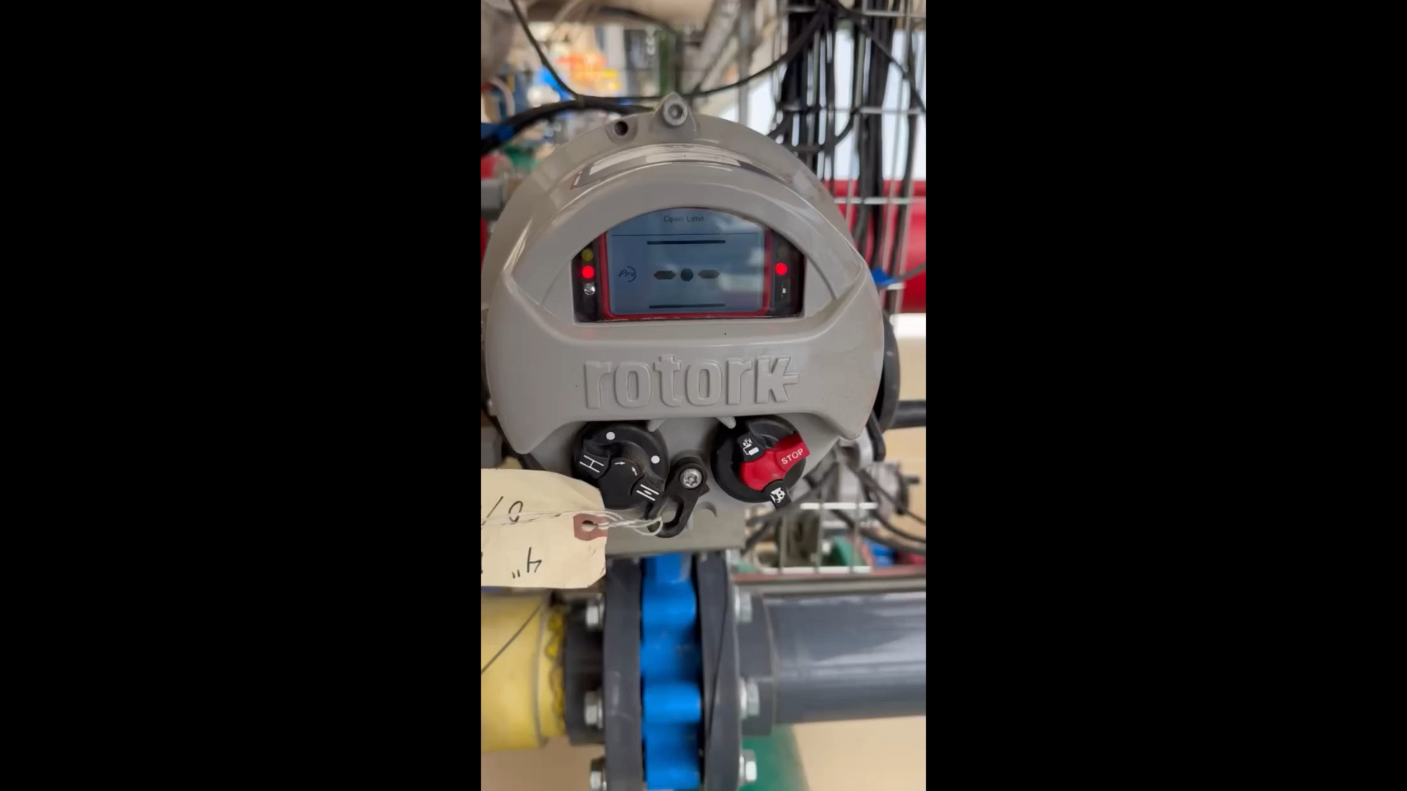

Slide 11
WHY S-TEK IS PART OF THE SOLUTION
The old controls were not built for today’s plant
BEFORE
AFTER
Original Filtronics control approach
S-TEK modern control platform
• Original vessel programming
• Pneumatic valve actuation
• Legacy PLC architecture
• Limited control over travel speed
• Less ability to tune backwash transitions
• New ControlLogix controller
• Programming Rotork actuators on Ethernet/IP
• Updated SCADA graphics
• Programmable valve timing
• Ability to tune backwash sequencing
• New Instrumentation integration
• Complete reprogramming of the
plant's operations
Modern controls allow staff to slow, sequence, and tune the hydraulic transition instead of simply opening and closing valves.
RCSD | Thompson Plant Hydraulic Reliability Improvements
11
Notes:
Talking points:
Do not spend much time on the PLC model numbers. The simple message: the original system could open and close valves, but the new system gives us the ability to control how fast and in what sequence they move.

Slide 12
Thompson Plant Hydraulic Reliability Improvements Costs
Project cost
Funding plan
Southwest Valve
$209,563.87
Line Item 72 – SCADA Replacement
$170,150.00
S-TEK
$170,150.00
Water Fund Unrestricted Reserves
$300,000.00
Zamora Electrical
$46,514.44
10% contingency
$42,622.83
Total project funding
$468,851.14
Total authorization
$468,851.14
Board action requested: approve project, authorize agreements, and approve the reserve appropriation for the remaining cost.
12
Notes:
Talking points:
Close by connecting funding to risk reduction. The full S-TEK amount comes from Line Item 72 because the work is directly SCADA and controls related. The balance requires a reserve appropriation because this was not a standalone budgeted project.

Slide 13
Recommended Board Actions
Leland Thompson Treatment Plant Valve, Electrical, and Controls Upgrade Project
Add project cost of $469,000 to the FY 26|27 Water Capital Improvement Project Budget
Authorize $170,150 from Line Item 72 - SCADA Replacement to fund the Stellar Technology & Automation (S-TEK) portion of the project
1
Approve Project
2
3
In total not-to-exceed
including 10% contingency and rounding adjustment
$469,000
Authorize GM to Issue Vendor Purchase Orders and Agreements with
Approve a FY 26|27 budget amendment appropriating $298,850 from Water Fund Unrestricted Operating Reserves to fund the remaining project costs.
$170,150
4
5
Southwest Valve & Equipment
$209,563.87
Line Item 72
Purchase order for Pratt valves and Rotork actuators.
6
Stellar Technology & Automation
$170,150.00
Agreement for PLC, SCADA, controls, programming, and commissioning.
7
Zamora Industrial Services
$46,514.44
Agreement for electrical improvements and motorized valve connections.
RCSD | Thompson Plant Hydraulic Reliability Improvements
13

